Slide 1
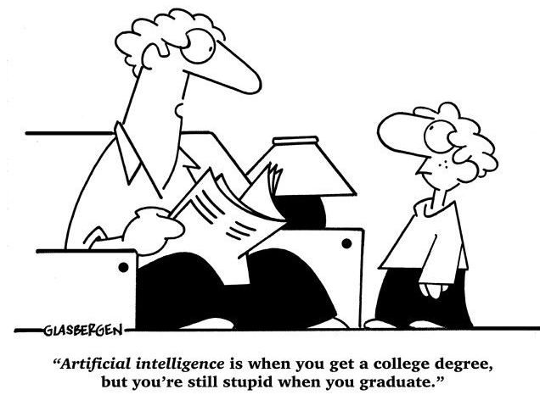
Deep Reinforcement Learning
汤斯亮（Siliang Tang）
siliang@zju.edu.cn

Slide 2
Outlines
Introduction of RL
Value-based RL (Q-Learning)
Deep Q-Network (DQN) – off policy
Policy-based RL (Policy optimization)
Policy Gradient – on policy
Value + Policy
Asynchronous Advantage Actor-Critic (A3C)
Model-based RL
Imitation Learning

Slide 3


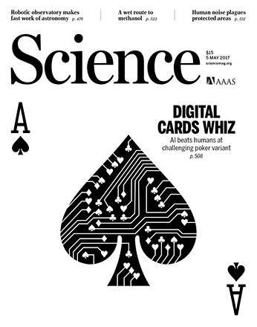
Deep Reinforcement Learning
Notes:
https://deepmind.com/research/dqn/

Slide 4
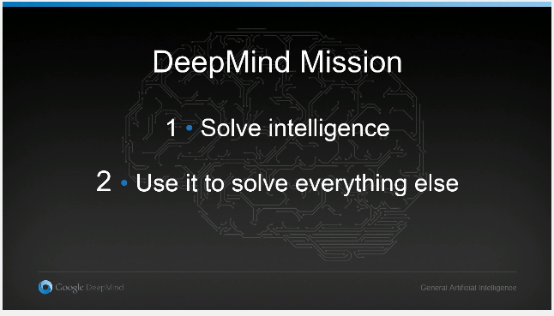
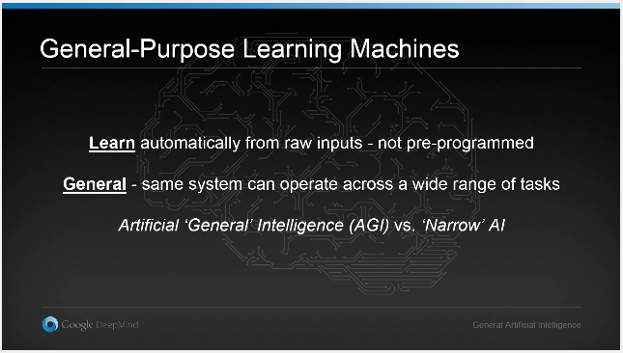
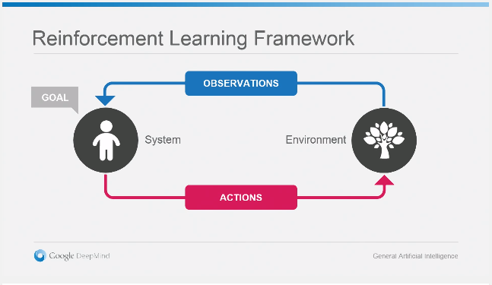
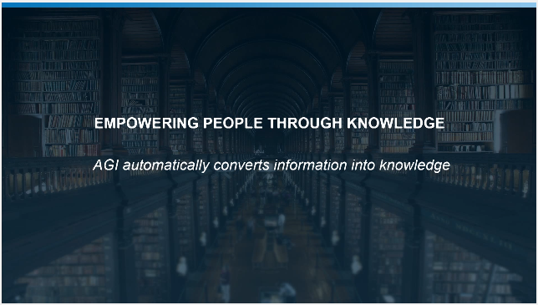
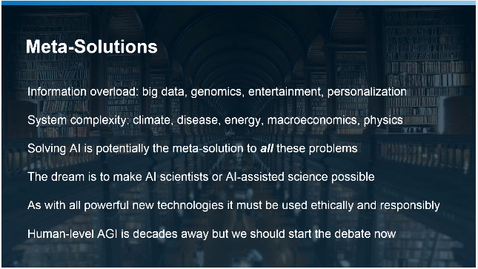
DeepMind
1. Demis Hassabis, CEO, DeepMind Technologies - The Theory of Everything, Google ZeitgeistMinds Talk
Notes:
DRL是一个非常新的东西，从诞生到现在才2年半时间，提到DRL就不得不提DeepMind，DeepMind是DRL领域的创始人与领导者。在Google的一个内部讲话中DM的CEO Demis提到DM的Mission…

Slide 5
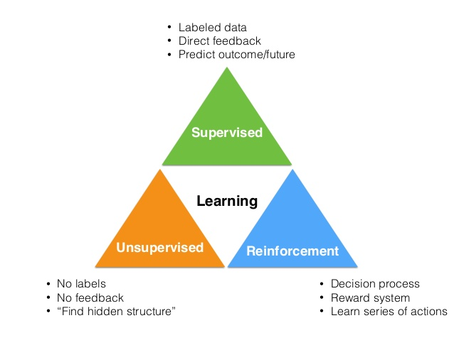
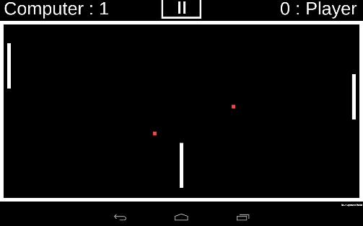
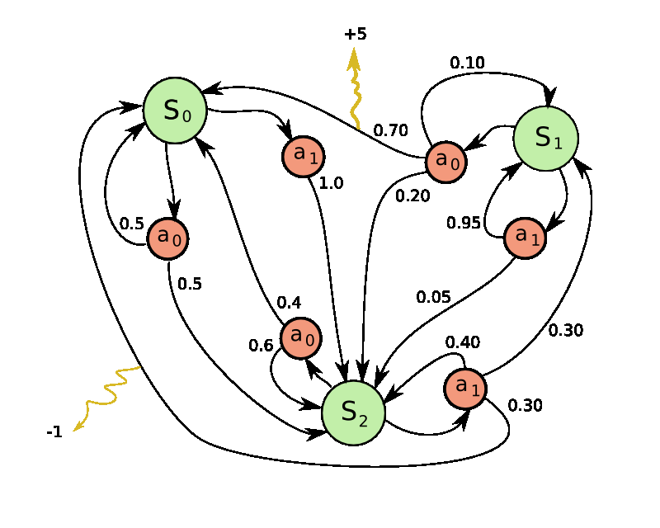
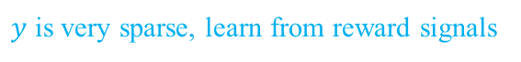
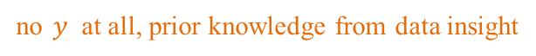
Machine Learning Algorithms
$y=f\left(x | θ\right)$learn mappings from error signals
CNN
Narrow AI
考霸
General AI
DBN
Graphical Models
学霸
正常人
no $y$ at all, prior knowledge from data insight
$y$ is very sparse, learn from reward signals
Notes:
什么是最接近AGI的方法呢？ML中所有学习方法都可以大致的归为三类，监督、无监督、强化学习。监督学习有标准答案，从错误中学习，学习的目标是尽可能的少犯错误；无监督学习不需要标准答案，它从数据中总结规律，数据驱动，no free lunch，需要先验假设，如数据分布、模型；但是现实世界中的大多数人在处理的任务，即没有标准答案，也没有专家指导，比如捕鱼，而强化学习可以可以通过从奖励中学习，因此是最接近GAI的存在。

Slide 6
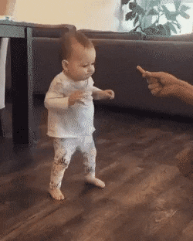
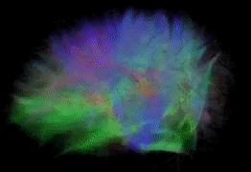
Reinforcement Learning in Humans
Human appear to learn to walk through “very few examples” of trial and error. How is an open question…
Possible answers:
Hardware: 230 million years of bipedal movement data.
Imitation Learning: Observation of other humans walking.
Algorithms: Better than backpropagation and stochastic gradient descent
3% of the neurons and 0.0001% of the synapses in the brain

Slide 7
Short Introduction of RL
2000 to 2013

Slide 8
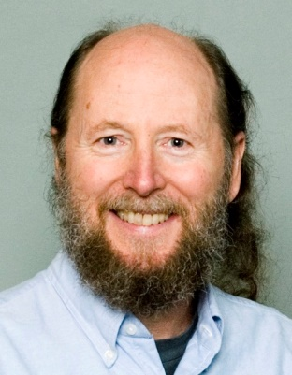
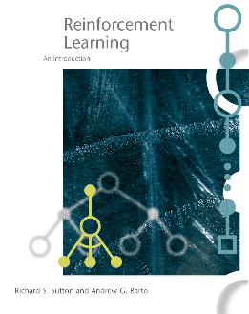
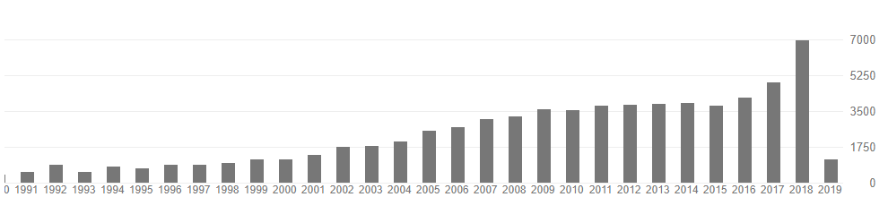
强化学习起源
形成于21世纪初 ^{[1]}
思想假设：心理学中的行为主义（learning by trial and error, or search and memory）
Law of Effect (Thorndike, 1911)
模型求解：控制学中的最优控制理论（optimal control and its solution using value functions and dynamic programming）
Bellman equation (Bellman, 1957a)
Markovian decision processes (Bellman, 1957b)
Policy iteration (Ron Howard, 1960)
其核心概念由阿尔伯塔大学的Richard S. Sutton整理完善
Richard S. Sutton
1. Sutton, R. S., & Barto, A. G. (1998). Reinforcement learning: An introduction(Vol. 1, No. 1). Cambridge: MIT press. (Google Scholar Citation 29156)
Notes:
阿尔伯塔大学

Slide 9
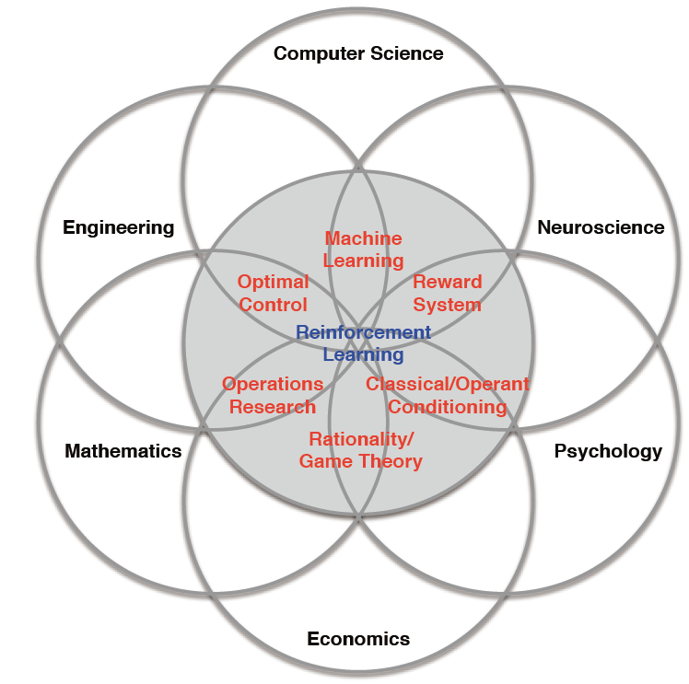
应用强化学习的基础学科
强化学习强调如何基于环境而行动，以取得最大化的预期利益。
这种思想具有普适性，因此在其他许多领域的理论研究中都有应用。
博弈论、控制论、运筹学、信息论、模拟优化方法、多Agent系统学习、群体智能、统计学以及遗传算法
六个基础学科

Slide 10
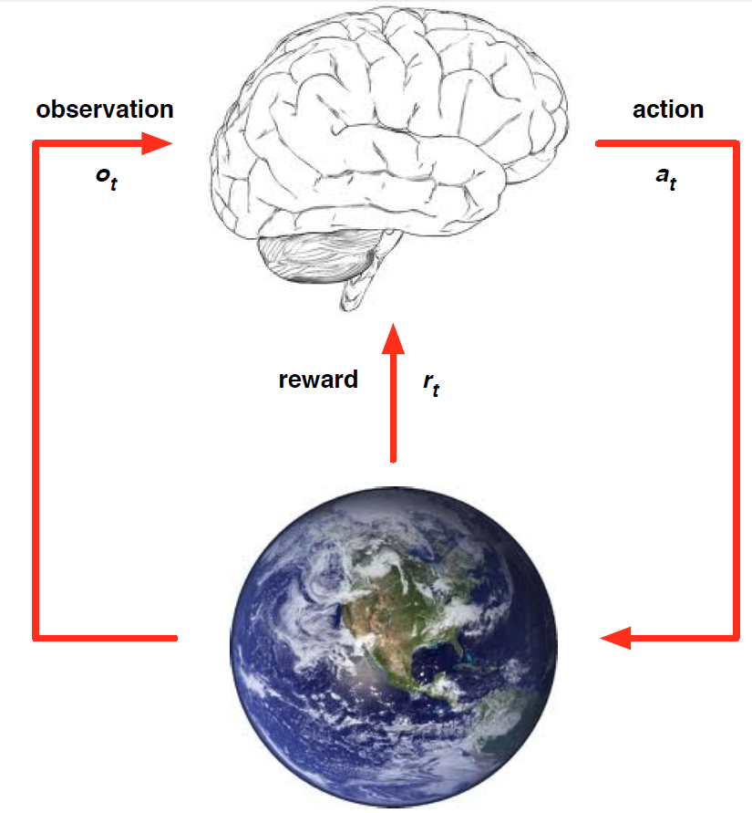
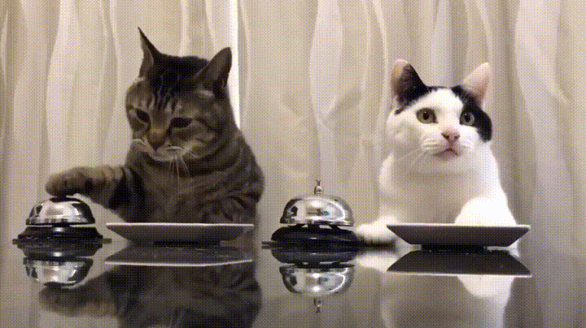
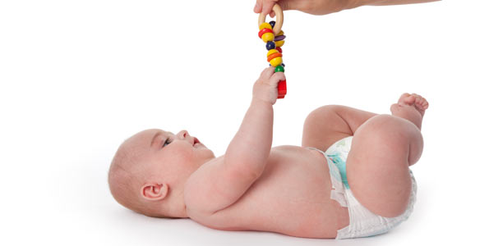
强化学习简介（基本概念）
个体如何在环境给予的奖励或惩罚的刺激(Reward -- r)下，逐步形成对刺激的预期，产生能获得最大利益的习惯性行为(Actions -- a)。
个体
在t时刻：
个体
执行action a_{t}
接收observation o_{t}
接收reward r_{t}
环境
接收action a_{t}
发出observation o_{t+1}
发出reward r_{t+1}
环境

Slide 11
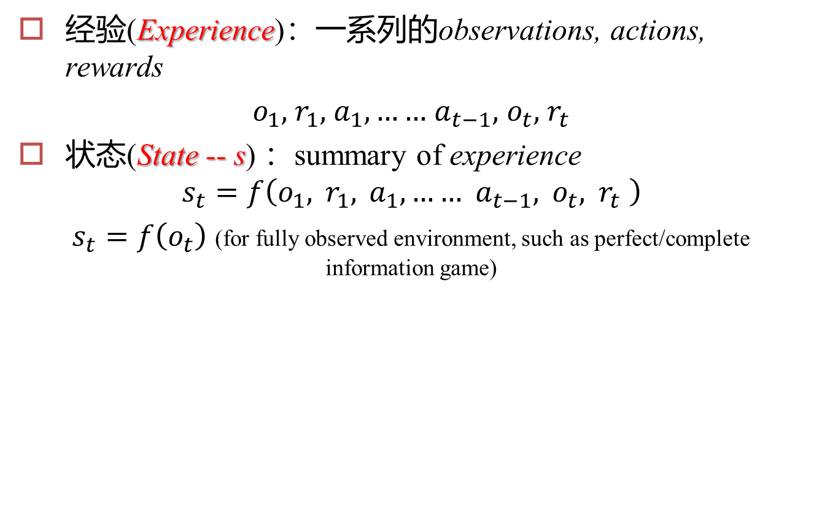
强化学习简介（基本概念）
经验(Experience)：一系列的observations, actions, rewards
$o_{1},$ $r_{1},$ $a_{1},……$ $a_{t−1},$ $o_{t},$ $r_{t}$
状态(State -- s) ：summary of experience
$$s_{t}=f\left(o_{1}, r_{1}, a_{1},…… a_{t−1}, o_{t}, r_{t} \right)$$
$s_{t}=f\left(o_{t}\right)$ (for fully observed environment, such as perfect/complete information game)

Slide 12
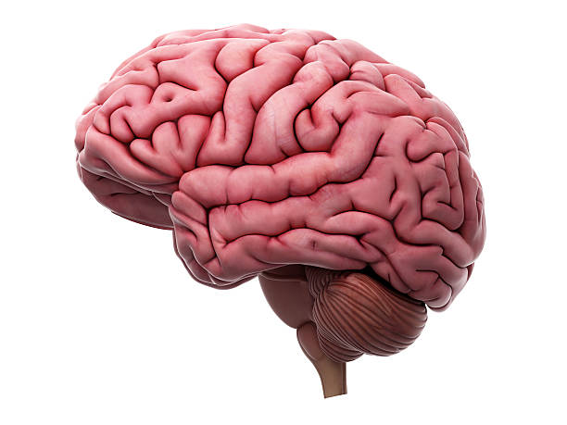
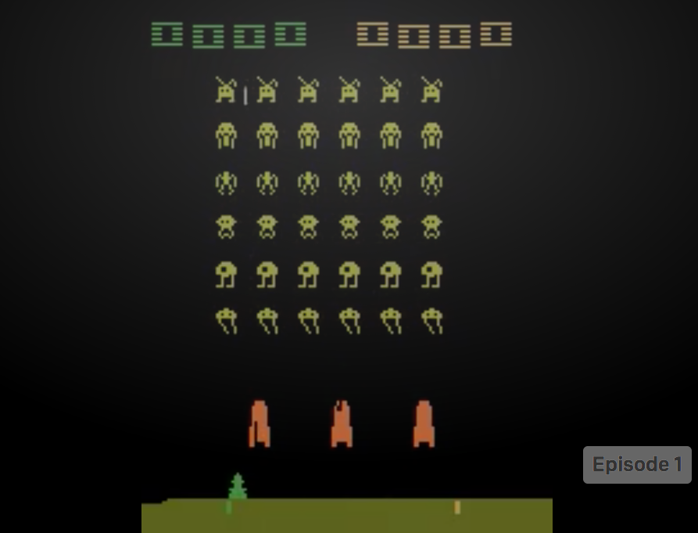
强化学习简介（基本概念）
Agent
Value-based RL
Estimate the expected returns to choose the optimal policy.
Reward
Action
Policy-based RL
Directly optimize the policy to get good return.
World Model
Model-based RL
Build a model of the environment and choose action based on the model.

Slide 13
RL Taxonomy
Model-free Approach
Policy-based
Value-based
Learning an Actor
Actor + Critic
Learning a Critic
Model-based Approach
Notes:
Alpha Go: policy-based + value-based + model-based

Slide 14
Value-based RL

Slide 15
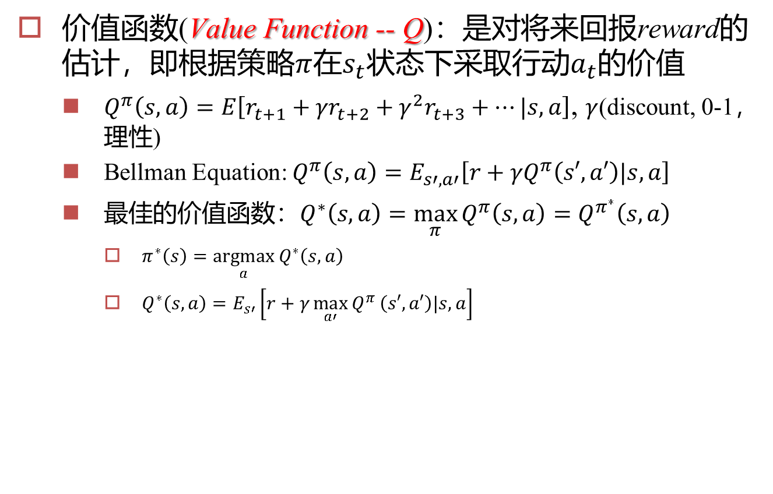
Q-Learning
价值函数(Value Function -- Q)：是对将来回报reward的估计，即根据策略$π$在$s_{t}$状态下采取行动$a_{t}$的价值
$Q^{π}\left(s,a\right)=E\left[r_{t+1}+{γr}_{t+2}+{γ^{2}r}_{t+3}+…|s,a\right]$, $γ$(discount, 0-1，理性)
Bellman Equation: $Q^{π}\left(s,a\right)=E_{s′,a′}\left[r+{γQ}^{π}\left(s′,a′\right)|s,a\right]$
最佳的价值函数：$Q^{∗}\left(s,a\right)=\max_{π}{Q^{π}\left(s,a\right)}=Q^{π^{∗}}\left(s,a\right)$
$π^{∗}\left(s\right)=\underset{a}{argmax}{Q^{∗}\left(s,a\right)}$
$Q^{∗}\left(s,a\right)=E_{s′}\left[r+{γ\max_{a′}{Q}}^{π}\left(s′,a′\right)|s,a\right]$
Agent
Value-based RL
Estimate the expected returns to choose the optimal policy.
Reward
Action
World Model

Slide 16
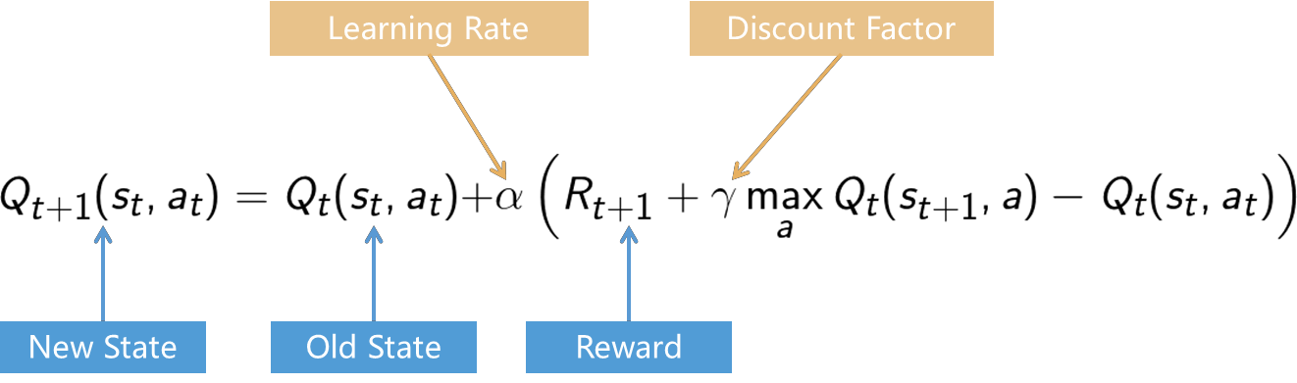
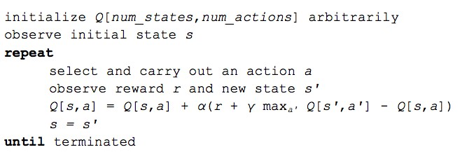
Q-Learning: Value Iteration
 | A1 | A2 | A3 | A4
S1 | +1 | +2 | -1 | 0
S2 | +2 | 0 | +1 | -2
S3 | -1 | +1 | 0 | -2
S4 | -2 | 0 | +1 | +1

Slide 17
Deep Q-Network (DQN)
2013年12月19日——2014年7月10日
2013.12.19: DQN上传至ArXiv
2014.1.26: Google收购DeepMind
2014.07.10: DQN投稿至Nature
2015.1.16: Nature接受DQN

Slide 18

深度强化学习(Nature DQN^{[2]})
在2013年DeepMind发表Deep Q-Network (DQN)^{[1]}相关工作之前强化学习(Q-learning)已经进入了瓶颈，主要原因是状态的维度灾难
DQN的基本思想是用深度神经网络来计算Q，采用的是基于价值(value-based)的方法
2015年2月DQN发表于Nature，并被Nature作为当月杂志的封面
“While reinforcement learning agents have achieved some successes in a variety of domains, their applicability has previously been limited to domains in which useful features can be handcrafted, or to domains with fully observed, low-dimensional state spaces.” ^{[2]}
1. Mnih V, Kavukcuoglu K, Silver D, et al. Playing atari with deep reinforcement learning[J]. arXiv preprint arXiv:1312.5602, 2013.
2. Mnih V, Kavukcuoglu K, Silver D, et al. Human-level control through deep reinforcement learning[J]. Nature, 2015, 518(7540): 529-533.

Slide 19
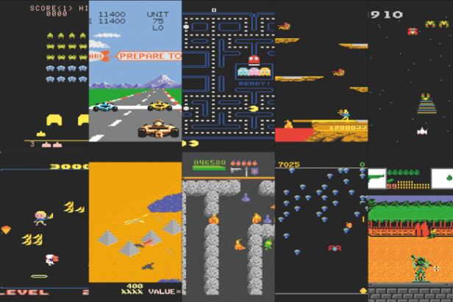
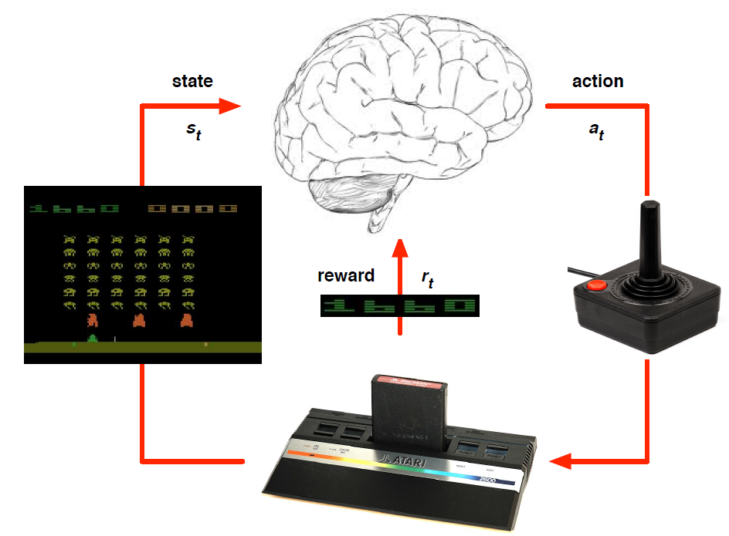
Nature DQN
在Nature论文中DQN被用来训练玩Atari Game ，这些游戏有着不同的目标，并被设计出来挑战人类
1个DQN vs 48个Atari Game

Slide 20
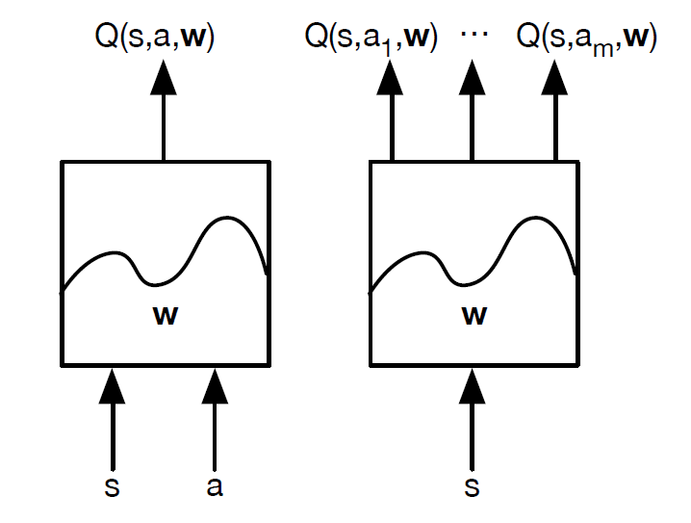
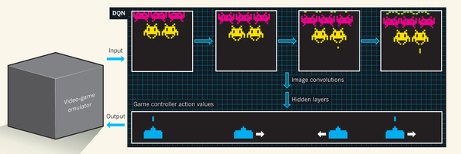
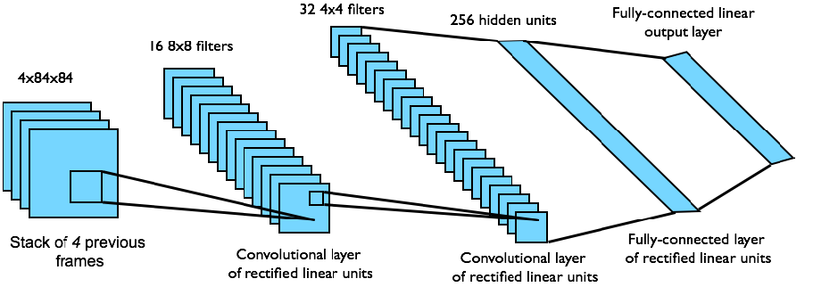
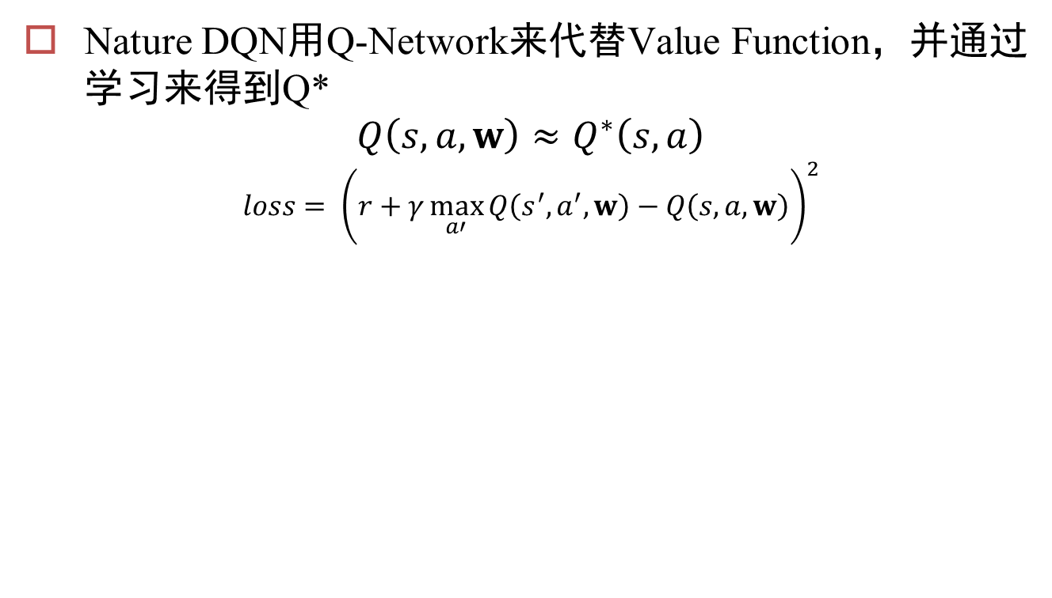
Nature DQN
Nature DQN用Q-Network来代替Value Function，并通过学习来得到Q*
$$Q\left(s,a,w\right)≈Q^{∗}\left(s,a\right)$$
$$loss= {\left(r+γ\max_{a′}{Q\left(s^{′},a^{′},w\right)}−Q\left(s,a,w\right)\right)}^{2}$$
target

Slide 21
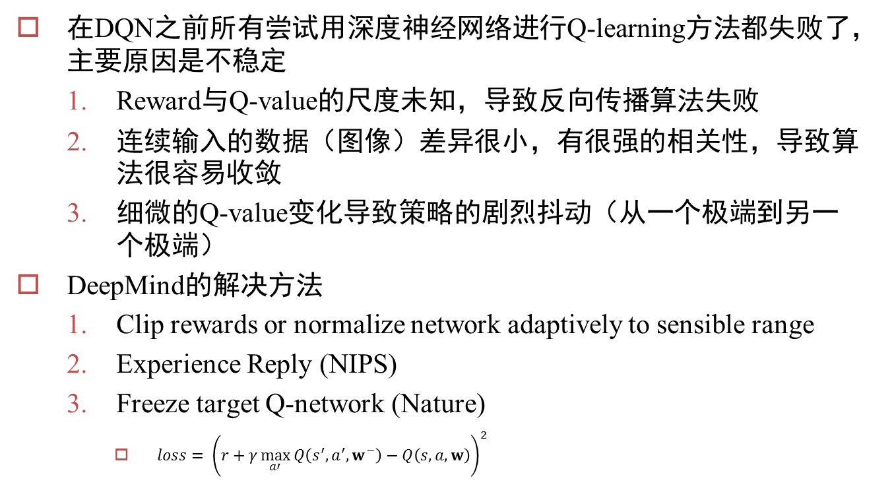
Nature DQN
在DQN之前所有尝试用深度神经网络进行Q-learning方法都失败了，主要原因是不稳定
Reward与Q-value的尺度未知，导致反向传播算法失败
连续输入的数据（图像）差异很小，有很强的相关性，导致算法很容易收敛
细微的Q-value变化导致策略的剧烈抖动（从一个极端到另一个极端）
DeepMind的解决方法
Clip rewards or normalize network adaptively to sensible range
Experience Reply (NIPS)
Freeze target Q-network (Nature)
$loss= {\left(r+γ\max_{a′}{Q\left(s^{′},a^{′},w^{−}\right)}−Q\left(s,a,w\right)\right)}^{2}$

Slide 22
Nature DQN

Slide 23
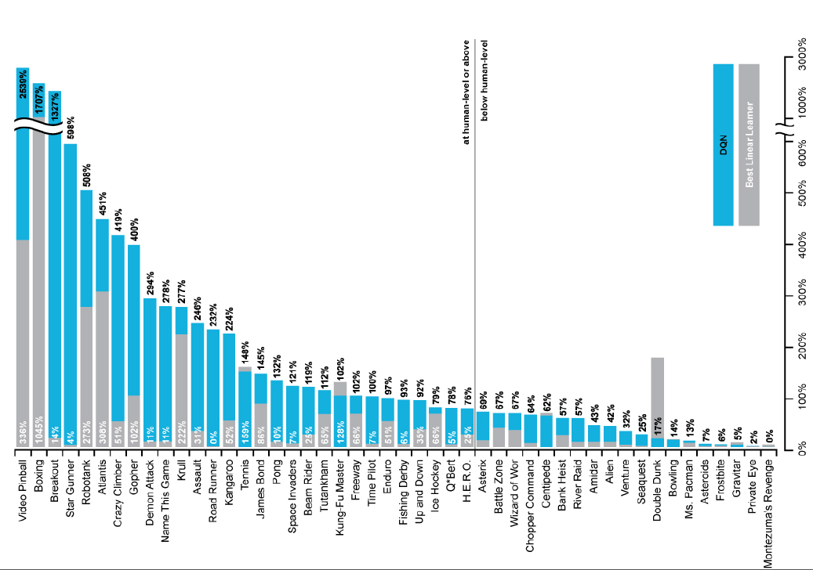
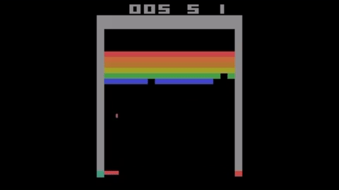
Nature DQN

Slide 24
Nature DQN
在2015年Nature DQN之后， DeepMind对其进行了一系列的重要的改进
Normalized DQN[1]
Prioritised Replay^{[2]} ：采用优先队列对Experience Memory中的经验，根据其在DQN中的error（surprise）进行加权
Double DQN^{[3]}
Duelling Network^{[4]} (ICML 2016 Best Paper)
注意这些方法是可以叠加使用的
Guez A, Silver, Van Hasselt H, arXiv, 2015
Schaul T, Quan J, Antonoglou I, et al. Prioritized experience replay. ICML, 2016
Van Hasselt H, Guez A, Silver D. Deep reinforcement learning with double Q-learning. AAAI, 2016.
Wang Z, de Freitas N, Lanctot M. Dueling network architectures for deep reinforcement learning. ICML, 2016

Slide 25
Policy-based RL

Slide 26
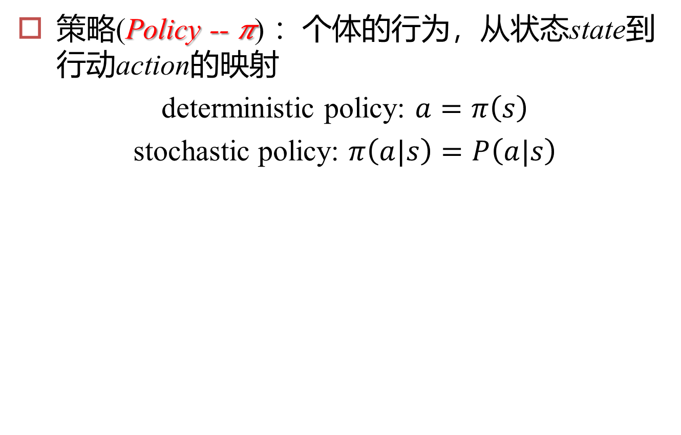
Policy-based RL
策略(Policy -- 𝜋) ：个体的行为，从状态state到行动action的映射
deterministic policy: $a=π\left(s\right)$
stochastic policy: $π\left(a|s\right)=P\left(a|s\right)$
Agent
Action
Policy-based RL
Directly optimize the policy to get good return.
World Model

Slide 27

Robot in a Room
+1
(Stochastic) model of the world:
-1
Action: UP
80%
move UP
START
10%
move RIGHT
• Reward +1 at [4,3], -1 at [4,2]
Reward -0.04 for each step
What’s the strategy to achieve max reward?
We can learn the model and plan
We can learn the value of (action, state) pairs and act greed/non-greedy
We can learn the policy directly while sampling from it

Slide 28
Optimal Policy for a Deterministic World
Reward: -0.04 for each step
 |  |  | +1
 |  |  | -1
actions: UP, DOWN, LEFT, RIGHT
When actions are deterministic:
UP
100%
0%
0%
move UP move LEFT move RIGHT
Policy: Shortest path.

Slide 29
Optimal Policy for a Stochastic World
Reward: -0.04 for each step
 |  |  | +1
 |  |  | -1
actions: UP, DOWN, LEFT, RIGHT
When actions are stochastic:
UP
80%
10%
10%
move UP move LEFT move RIGHT
Policy: Shortest path. Avoid -UP around -1 square.

Slide 30
Optimal Policy for a Stochastic World
Reward: -2 for each step
 |  |  | +1
 |  |  | -1
actions: UP, DOWN, LEFT, RIGHT
When actions are stochastic:
UP
80%
10%
10%
move UP move LEFT move RIGHT
Policy: Shortest path.

Slide 31
Optimal Policy for a Stochastic World
Reward: -0.1 for each step
Reward: -0.04 for each step
 |  |  | +1
 |  |  | -1
 |  |  | +1
 |  |  | -1
More urgent
Less urgent

Slide 32
Optimal Policy for a Stochastic World
Reward: +0.01 for each step
 |  |  | +1
 |  |  | -1
actions: UP, DOWN, LEFT, RIGHT
When actions are stochastic:
UP
80%
10%
10%
move UP move LEFT move RIGHT
Policy: Longest path.

Slide 33
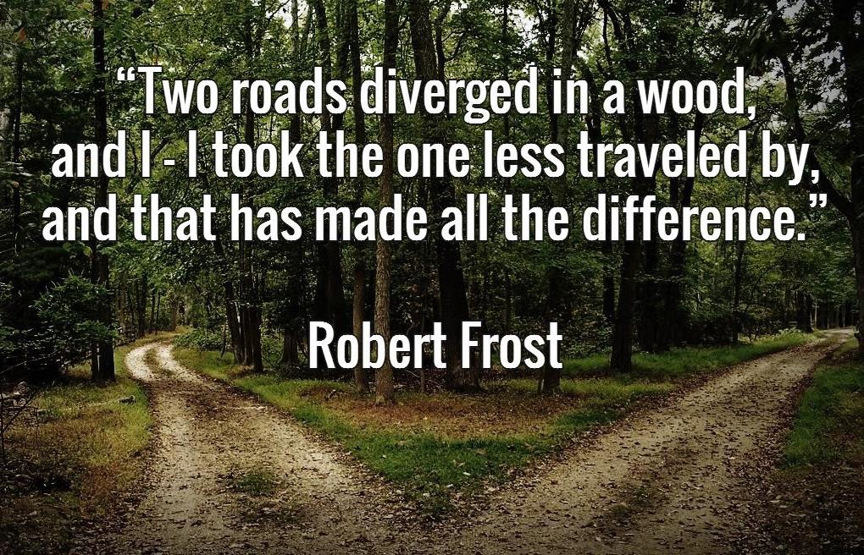
Lessons from Robot in Room
Environment model has big impact on optimal policy
Reward structure has big impact on optimal policy

Slide 34
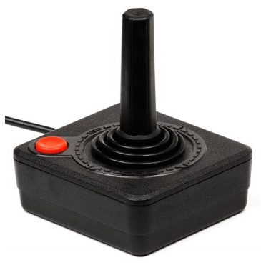
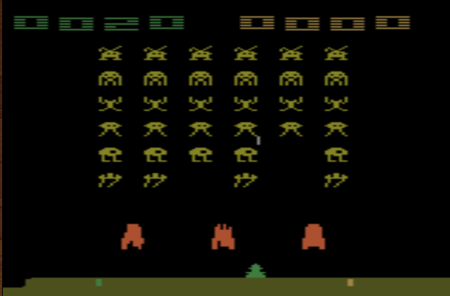
Policy Gradient – Actor
Actor is a Neural Network
Input : the observation of machine represented as a vector or a matrix
Output : each action corresponds to a neuron in output layer
NN as actor
left
0.7
Probability of taking the action
…
right
0.2
…
fire
0.1
pixels
Sample an action based on the probability or argmax
Actor can also have continuous action.
Notes:
Taking the action with the highest score

Slide 35
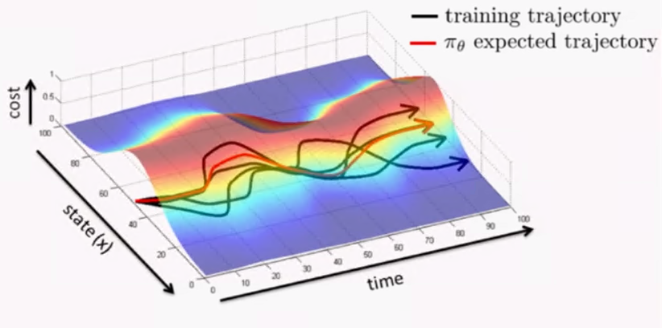
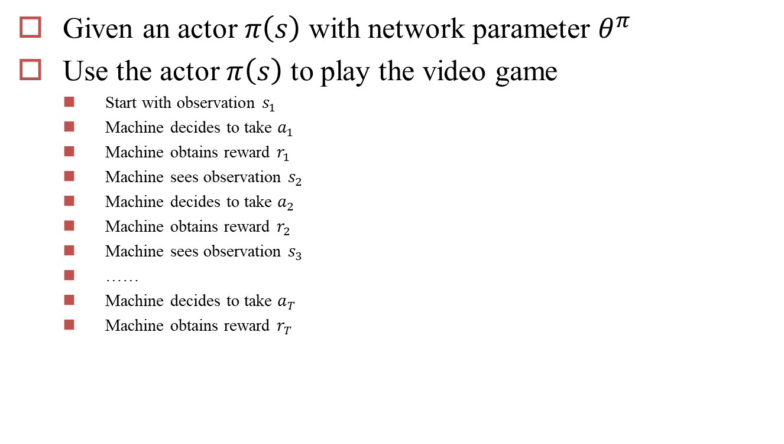
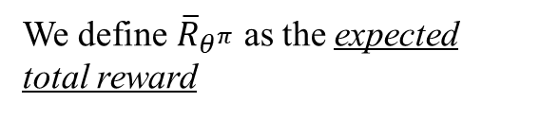
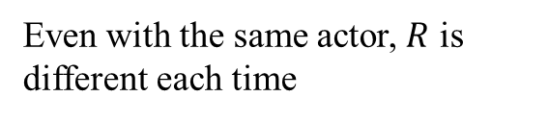
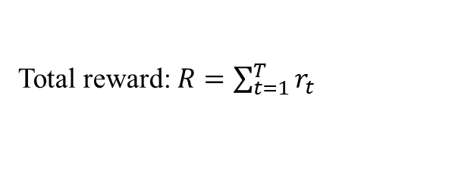
Goodness of an Actor
Given an actor $π\left(s\right)$ with network parameter $θ^{π}$
Use the actor $π\left(s\right)$ to play the video game
Start with observation $s_{1}$
Machine decides to take $a_{1}$
Machine obtains reward $r_{1}$
Machine sees observation $s_{2}$
Machine decides to take $a_{2}$
Machine obtains reward $r_{2}$
Machine sees observation $s_{3}$
……
Machine decides to take $a_{T}$
Machine obtains reward $r_{T}$
Total reward: $R=\sum_{t=1}^{T}{r_{t}}$
Even with the same actor, $R$ is different each time
Randomness in the actor and the game
Game Over
We define ${\overline{R}}_{θ^{π}}$ as the expected total reward
${\overline{R}}_{θ^{π}}$evaluates the goodness of an actor $π\left(s\right)$

Slide 36
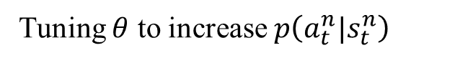
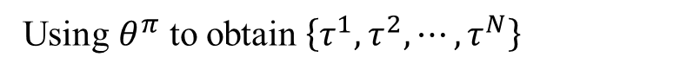
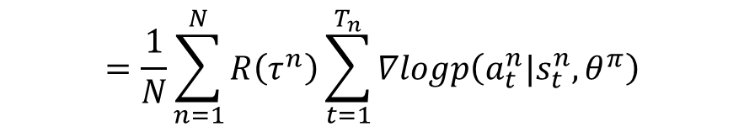
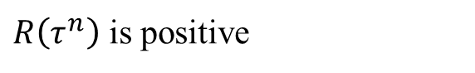
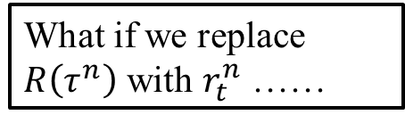






Policy Gradient – Actor
$$θ^{π^{′}}←θ^{π}+η∇{\overline{R}}_{θ^{π}}$$
Using $θ^{π}$ to obtain $\left\{τ^{1},τ^{2},⋯,τ^{N}\right\}$
$$∇{\overline{R}}_{θ^{π}}≈\frac{1}{N}\sum_{n=1}^{N}{R\left(τ^{n}\right)∇logP\left(τ^{n}|θ^{π}\right)}$$
$$=\frac{1}{N}\sum_{n=1}^{N}{R\left(τ^{n}\right)\sum_{t=1}^{T_{n}}{∇logp\left(a_{t}^{n}|s_{t}^{n},θ^{π}\right)}}$$
$$=\frac{1}{N}\sum_{n=1}^{N}{\sum_{t=1}^{T_{n}}{R\left(τ^{n}\right)∇logp\left(a_{t}^{n}|s_{t}^{n},θ^{π}\right)}}$$
What if we replace $R\left(τ^{n}\right)$ with $r_{t}^{n}$ ……
If in $τ^{n}$ machine takes $a_{t}^{n}$ when seeing $s_{t}^{n}$
$R\left(τ^{n}\right)$ is positive
Tuning $θ$ to increase $p\left(a_{t}^{n}|s_{t}^{n}\right)$
$R\left(τ^{n}\right)$ is negative
Tuning $θ$ to decrease $p\left(a_{t}^{n}|s_{t}^{n}\right)$
It is very important to consider the cumulative reward $R\left(τ^{n}\right)$ of the whole trajectory $τ^{n}$ instead of immediate reward $r_{t}^{n}$

Slide 37
Value + Policy Asynchronous Advantage Actor-Critic (A3C)
Volodymyr Mnih, Adrià Puigdomènech Badia, Mehdi Mirza, Alex Graves, Timothy P. Lillicrap, Tim Harley, David Silver, Koray Kavukcuoglu, “Asynchronous Methods for Deep Reinforcement Learning”, ICML, 2016

Slide 38







Critic
A critic does not determine the action.
Given an actor $π$, it evaluates the how good the actor is
State value function $V^{π}\left(s\right)$
When using actor $π$, the cumulated reward expects to be obtained after seeing observation (state) s
$$V^{π}$$
$$V^{π}\left(s\right)$$
s
scalar
$V^{π}\left(s\right)$ is large
$V^{π}\left(s\right)$ is smaller
Notes:
(Lots of aliens to be killed, and the shields still exist)

Slide 39




Critic
$$V^{以前的阿光}\left(大馬步飛\right)=bad$$
$$V^{變強的阿光}\left(大馬步飛\right)=good$$
Notes:
http://combiboilersleeds.com/picaso/critics/critics-4.html

Slide 40














How to estimate $V^{π}\left(s\right)$
Monte-Carlo based approach
The critic watches $π$ playing the game
After seeing $s_{a}$,
$$V^{π}$$
Until the end of the episode, the cumulated reward is $G_{a}$
$$s_{a}$$
$$V^{π}\left(s_{a}\right)$$
$G_{a}$
After seeing $s_{b}$,
$$V^{π}$$
Until the end of the episode, the cumulated reward is $G_{b}$
$$s_{b}$$
$$V^{π}\left(s_{b} \right)$$
$G_{b}$

Slide 41










How to estimate $V^{π}\left(s\right)$
Temporal-Difference approach
$$⋯s_{t},a_{t},r_{t},s_{t+1}⋯$$
$$V^{π}$$
$$V^{π}\left(s_{t}\right)+r_{t}=V^{π}\left(s_{t+1} \right)$$
$$s_{t}$$
$$V^{π}\left(s_{t}\right)$$
-
$$V^{π}\left(s_{t}\right)−V^{π}\left(s_{t+1}\right)$$
$$r_{t}$$
$$V^{π}$$
$$s_{t+1}$$
$$V^{π}\left(s_{t+1}\right)$$
Some applications have very long episodes, so that delaying all learning until an episode's end is too slow.
Notes:
The next most obvious advantage of TD methods over Monte Carlo methods is
that they are naturally implemented in an on-line, fully incremental fashion. With
Monte Carlo methods one must wait until the end of an episode, because only then
is the return known, whereas with TD methods one need wait only one time step.
Surprisingly often this turns out to be a critical consideration Other applications are continuing tasks and have no episodes at all.

Slide 42





MC v.s. TD
[Sutton, v2, Example 6.4]
The critic has the following 8 episodes
$s_{a},r=0,s_{b},r=0$, END
$s_{b},r=1$, END
$s_{b},r=1$, END
$s_{b},r=1$, END
$s_{b},r=1$, END
$s_{b},r=1$, END
$s_{b},r=1$, END
$s_{b},r=0$, END
$$V^{π}\left(s_{b}\right)=3/4$$
$$V^{π}\left(s_{a}\right)=?$$
0?
3/4?
Monte-Carlo:
$$V^{π}\left(s_{a}\right)=0$$
Temporal-difference:
$$V^{π}\left(s_{a}\right)+r=V^{π}\left(s_{b}\right)$$
3/4
0
3/4
(The actions are ignored here.)

Slide 43

Actor-Critic
$π$ interacts with the environment
𝜋 interacts with the environment
Learning $V^{π}\left(s\right)$
Learning 𝑉^𝜋 (𝑠)
Update actor from $π→π’$ based on $V^{π}\left(s\right)$
Update actor from 𝜋→𝜋’ based on 𝑉^𝜋 (𝑠)
$$π=π^{′}$$
TD or MC
?

Slide 44









Advantage Actor-Critic
$$θ^{π^{′}}←θ^{π}+η∇{\overline{R}}_{θ^{π}}$$
$$∇{\overline{R}}_{θ^{π}}$$
$$=\frac{1}{N}\sum_{n=1}^{N}{\sum_{t=1}^{T_{n}}{R\left(τ^{n}\right)∇logp\left(a_{t}^{n}|s_{t}^{n},θ^{π}\right)}}$$
Evaluated by critic
Baseline is added
Advantage Function:
$$r_{t}^{n}−\left(V^{π}\left(s_{t}^{n}\right)−V^{π}\left(s_{t+1}^{n}\right)\right)$$
The reward $r_{t}^{n}$ we truly obtain when taking action $a_{t}^{n}$
Expected reward $r_{t}^{n}$ we obtain if we use actor $π$
Positive advantage function
Increasing the prob. of action $a_{t}^{n}$
Negative advantage function
decreasing the prob. of action $a_{t}^{n}$
Notes:
Using Q,

Slide 45



Advantage Actor-Critic
Tips
The parameters of actor $π\left(s\right)$ and critic $V^{π}\left(s\right)$ can be shared
Use output entropy as regularization for $π\left(s\right)$
Larger entropy is preferred $→$ exploration
Network
left
Network
right
$$s$$
fire
Network
$$V^{π}\left(s\right)$$

Slide 46








Asynchronous
$$θ^{1}$$
$$+η∆θ$$
1. Copy global parameters
$$θ^{2}$$
2. Sampling some data
(other workers also update models)
3. Compute gradients
$$∆θ$$
4. Update global models
$$θ^{1}$$
$$θ^{1}$$
$$∆θ$$

Slide 47
Model-based RL
Model-based RL is an under-explored area of research

Slide 48








Model-based RL
When the rule is known or easy to learn, we can learn the model
supervised learning
This is a supervised learning problem!
How to select a policy using a model?
Iteratively compute the value and optimal action for each state.
Sample experience from the model.

Slide 49

Why use model-based RL?
sample efficiency
transferability & generality
about 20 minutes of experience on a real robot
1,000,000 steps
(1,000 episodes)
(~ 3 hours real time)
10,000,000 steps
(10,000 episodes)
(~ 1.5 days real time)
100,000,000 steps
(100,000 episodes) (~ 15 days real time)
3 Types of Reinforcement Learning

Slide 50


Algorithm v0
collect random samples, train dynamics, plan
Back propagate through model to optimize policy
backpropagate

Slide 51


Algorithm v0
Pro: simple, no iterative procedure
Con: distribution mismatch problem
Distribution mismatch problem becomes exacerbated as we use more expressive model classes
go right to get higher!

Slide 52

Algorithm v1:
iteratively collect data, refit model
Pro: simple, solves distribution mismatch
Con: might make mistakes with imperfect model

Slide 53



Algorithm v2a
Pro: robust to small model errors
Con: computationally expensive, but have a planning algorithm available
model-predictive control (MPC)
every N steps
instead sample to choose actions, one can:
Sample action sequences from some distribution (e.g. uniformly at random)
Run actions through model to prediction future
Choose action leading to the best future

Slide 54






What kind of models can we use?
Gaussian process neural network
image: Punjani & Abbeel ‘14
other

Slide 55



Handling high-dimensional observations
one option: provide image of goal
also: no reward signal with only observations

Slide 56


Learning in Latent Space
Key idea: learn embedding
, then learn model in latent space

Slide 57



Learning in Latent Space
Key idea: learn embedding
then do model-based RL in latent space
NIPS 2015

Slide 58
Learning in Latent Space
What is reward for optimizing policy?
reward signal:

Slide 59



Learning in Latent Space
How to optimize latent embedding g?
learn embedding & model jointly
embedding is smooth and structured

Slide 60

Modeling directly in observation space
Recall MPC
every N steps
action-conditioned video prediction

Slide 61
Model-Based vs. Model-Free
Models:
+ Easy to collect data in a scalable way (self-supervised)
+ Possibility to transfer across tasks
+ Typically require a smaller quantity of supervised data
Models don’t optimize for task performance
Sometimes harder to learn than a policy
Often need assumptions to learn complex skills (continuity, resets)
Model-Free:
+ Makes little assumptions beyond a reward function
+ Effective for learning complex policies
Require a lot of experience (slower)
Not transferable across tasks
Ultimately we will want both!

Slide 62
Combining Model-Based & Model-Free
use roll-outs from model as experience
Sutton ’90, Gu et al. ICML ‘16
use model as baseline
Chebotar et al. ICML ‘17
use model for exploration
Stadie et al. arXiv ’15, Oh et al. NIPS ’16
model-free policy with planning capabilities
Tamar et al. NIPS ’16, Pascanu et al. ‘17
model-based look-ahead
Guo et al. NIPS ’14, Silver et al. Nature‘16

Slide 63
Imitation Learning

Slide 64
Introduction
Also known as learning by demonstration, apprenticeship learning, An expert demonstrates how to solve the task
Machine can also interact with the environment, but cannot explicitly obtain reward.
It is hard to define reward in some tasks.
Hand-crafted rewards can lead to uncontrolled behavior
Three approaches:
Behavior Cloning
Inverse Reinforcement Learning (Generative Adversarial Network)

Slide 65



Behavior Cloning
Self-driving cars as example
Yes, this is supervised learning.
Expert (Human driver): 向前
observation
Machine: 向前
Training data:
($o_{1}$, ${\hat{a}}_{1}$)
($o_{2}$, ${\hat{a}}_{2}$)
($o_{3}$, ${\hat{a}}_{3}$)
……
NN
o_{i}
a_{i}
$${\hat{a}}_{i}$$
Actor

Slide 66

Behavior Cloning
Problem
Expert only samples limited observation (states)
?
Expert
Let the expert in the states seem by machine
Dataset Aggregation

Slide 67







Behavior Cloning
Dataset Aggregation
Get actor $π_{1}$ by behavior cloning
Expert
Using $π_{1}$to interact with the environment
Expert
Ask the expert to label the observation of $π_{1}$
$π_{1}$
Using new data to train $π_{2}$

Slide 68

Behavior Cloning
The agent will copy every behavior, even irrelevant actions.
https://www.youtube.com/watch?v=j2FSB3bseek

Slide 69


Behavior Cloning
Major problem: if machine has limited capacity, it may choose the wrong behavior to copy.
Some behavior must copy, but some can be ignored.
Supervised learning takes all errors equally
speech
speech
NN
NN
o_{i}
a_{i}
o_{i}
a_{i}
gesture
gesture
Actor
Actor
Notes:
http://dariusforoux.com/stop-imitating-habits-successful-people/

Slide 70

Mismatch
o_{i}
Actor
a_{i}
In supervised learning, we expect training and testing data have the same distribution.
In behavior cloning:
Training: $\left(o,a\right)\sim \hat{π}$ (expert)
Action a taken by actor influences the distribution of o
Testing: $\left(o′,a′\right)\sim π^{∗}$(actor cloning expert)
If $\hat{π}=π^{∗}$, $\left(o,a\right)$ and $\left(o′,a′\right)$ from the same distribution
If $\hat{π}$ and $π^{∗}$ have difference, the distribution of $o$ and $o′$ can be very different.

Slide 71



Inverse Reinforcement Learning
Environment Dynamics
P(s’|s,a)
trajectory $\hat{τ}$
$$\left(s_{1}, {\hat{a}}_{1}\right),\left(s_{2},{\hat{a}}_{2}\right)⋯$$
Reward Function
$$R\left(τ\right)$$
Inverse Reinforcement Learning
Optimal Policy $\hat{π}$
Reinforcement Learning
Using the reward function to find a policy $π^{∗}$
Modeling reward can be easier. Simple reward function can lead to complex policy.
Notes:
Inverse RL vs. behavioral cloning
Which has the most succinct description: π* vs. R*?

Slide 72





Inverse Reinforcement Learning
Original RL:
given a reward function $R\left(τ\right)$, $R\left(τ\right)=\sum_{t=1}^{T}{r\left(s_{t},a_{t}\right)}$
Initialize an actor $π$
In each iteration
using $π$ to interact with the environment N times, obtain $\left\{τ^{1},τ^{2},⋯,τ^{N}\right\}$
Update $π$ to maximize ${\overline{R}}_{π}$
The actor $π$ is the optimal actor $\hat{π}$
$$τ=\left\{s_{1},a_{1},r_{1},s_{2},a_{2},r_{2},⋯,s_{T},a_{T},r_{T}\right\}$$
$$R\left(τ\right)=\sum_{t=1}^{T}{r_{t}}$$
$$=\sum_{τ}{R\left(τ\right)P\left(τ|π\right)}$$
$$≈\frac{1}{N}\sum_{n=1}^{N}{R\left(τ^{n}\right)}$$
$${\overline{R}}_{π}$$

Slide 73



Inverse Reinforcement Learning
Inverse RL:
$R\left(τ\right)$ or $r\left(s,a\right)$ is to be found
Given expert policy $\hat{π}$ (Given the trajectories $\left\{{\hat{τ}}_{1},{\hat{τ}}_{2},⋯,{\hat{τ}}_{N}\right\}$)
The expert policy $\hat{π}$ is the actor that can obtain maximum expected reward
Find reward function that fulfills the above statements (explaining expert behavior)
$${\overline{R}}_{\hat{π}}>{\overline{R}}_{π}$$
For all other actors $π$

Slide 74





Framework of IRL
$$φ\left(π\right)=\frac{1}{N}\sum_{n=1}^{N}{\sum_{t=1}^{T}{f\left(s_{t},a_{t}\right)}}$$
Expert $\hat{π}$
Update reward function such that:
$$\left\{{\hat{τ}}_{1},{\hat{τ}}_{2},⋯,{\hat{τ}}_{N}\right\}$$
Self driving: record human drivers
$${\overline{R}}_{\hat{π}}>{\overline{R}}_{π}$$
random reward function
Robot: grab the arm of robot
$$\left\{τ_{1},τ_{2},⋯,τ_{N}\right\}$$
Assume
Update actor:
Actor $π$
$$π^{∗}=arg\max_{π}{{\overline{R}}_{π}}$$
$$r_{t}=w∙f\left(s_{t},a_{t}\right)$$
By Reinforcement learning

Slide 75
Any Questions?

